Slide 1

Livre de Prières:
A Book Woven in History
Presenter: Katie Killian

Slide 2

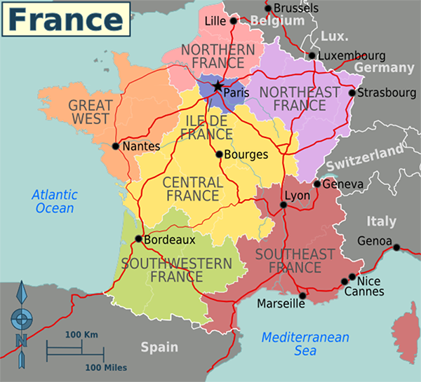
Livre de Prières: Quick Facts
"Prayer Book"
Located in Special Collections
Donated for 50th Anniversary
Current approx. value $55,000
50-60 copies
Made in France, 19th Century
Each copy is unique – different bindings
Pages woven of silk, mounted on paper

Slide 3
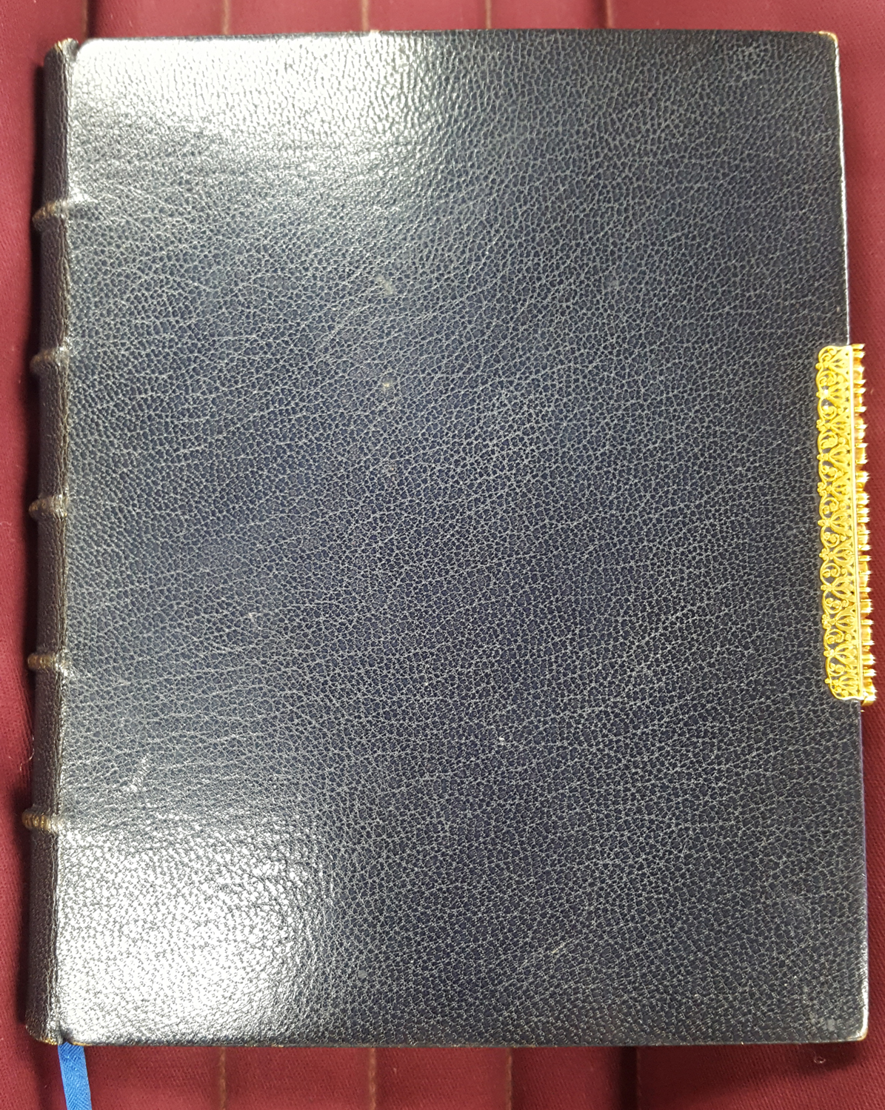
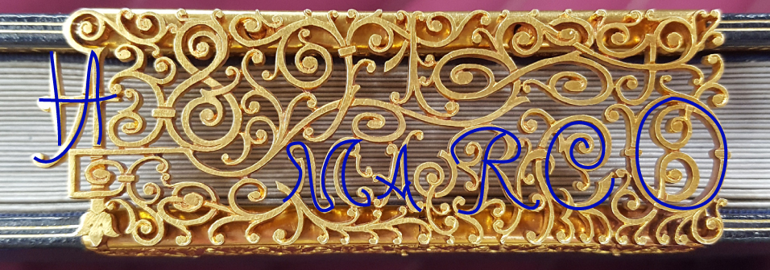
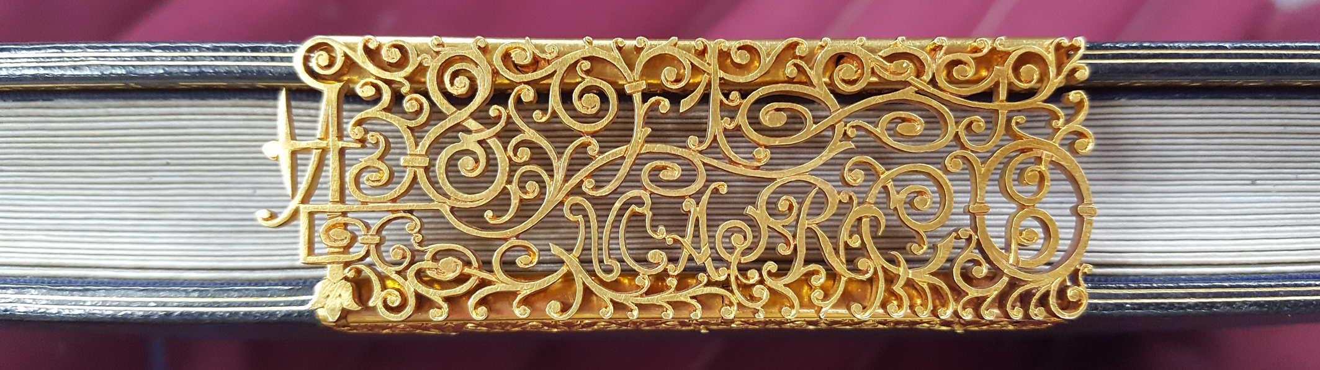
Livre de Prières: Binding
Each set of pages was sold
individually and unbound
Simple design
Metal clasp

Slide 4
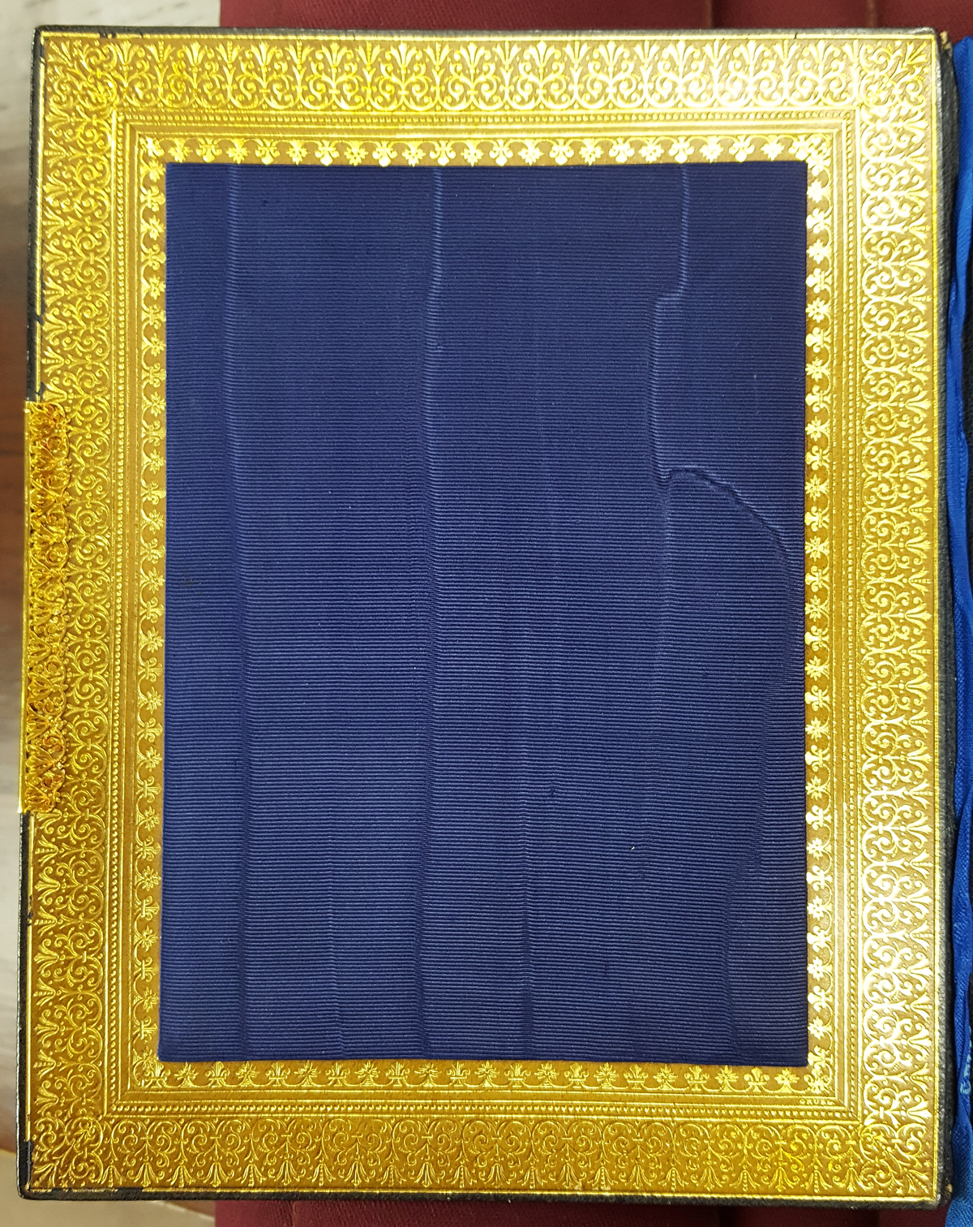
Livre de Prières: Inside Cover
Navy watered silk
Intricate gold border

Slide 5
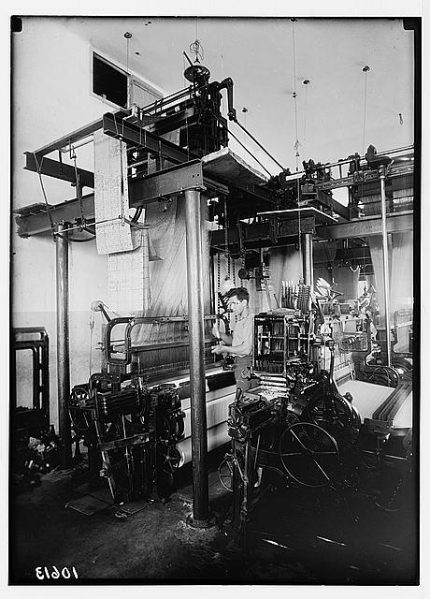
Livre de Prières: Woven in Silk
Pages woven of silk
Jacquard Loom
Programmable – punch cards
considered a precursor to the computer
Video clip:
https://www.youtube.com/watch?v=OlJns3fPItE
American Colony (Jerusalem). Photo Dept. A Jacquard Silk Loom in Operation. 1939. Prints and Photographs Division, Library of Congress, Washington D.C. In Library of Congress Prints and Photographs Online Catalogue. http://www.loc.gov/pictures/item/mpc2004003245/PP/.

Slide 6
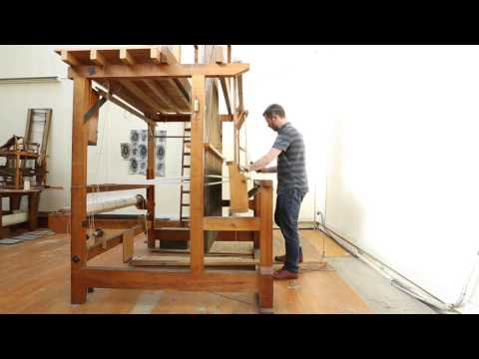
Livre de Prières: Woven in Silk

Slide 7
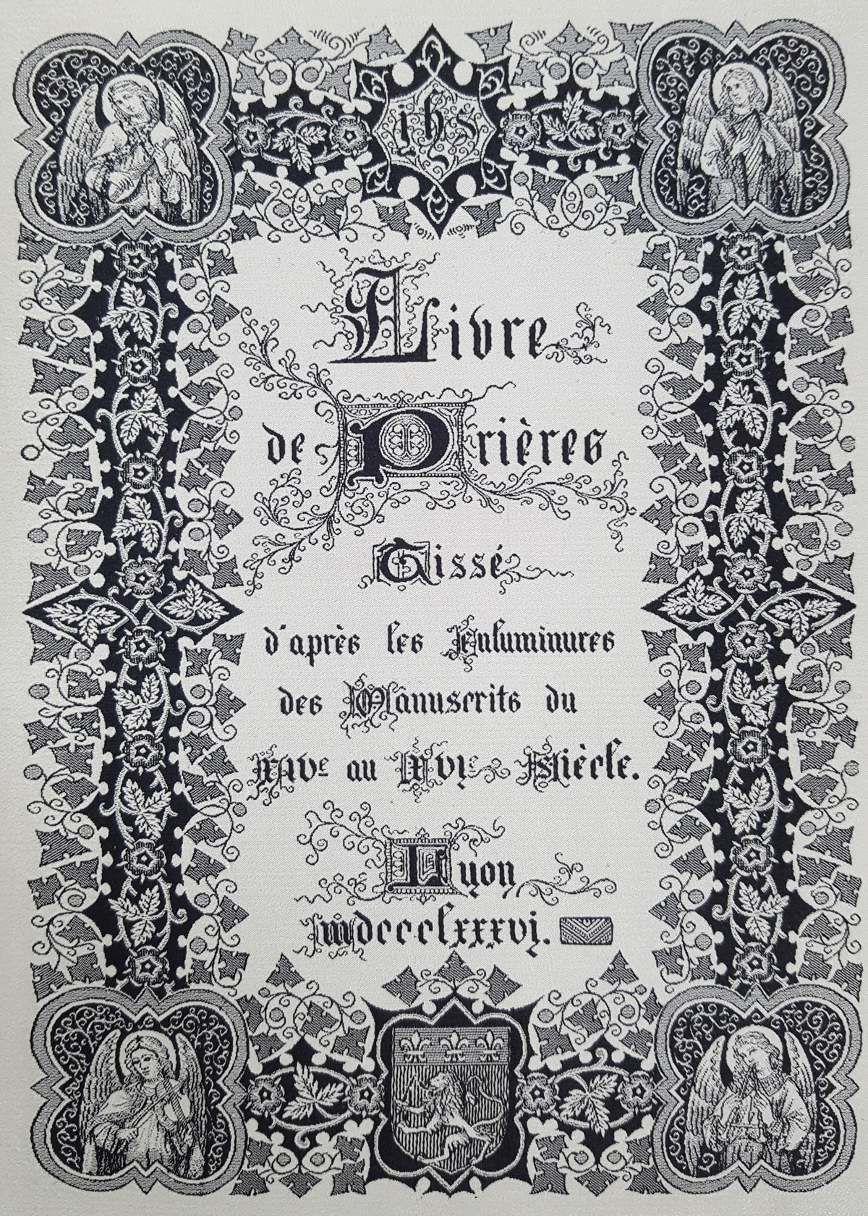
Livre de Prières: Title Page
Illuminations (fancy lettering)
Studied many manuscripts of the
14th - 16th Centuries
  Book of Hours
Created in Lyon, France in 1886
  See Coat of Arms

Slide 8
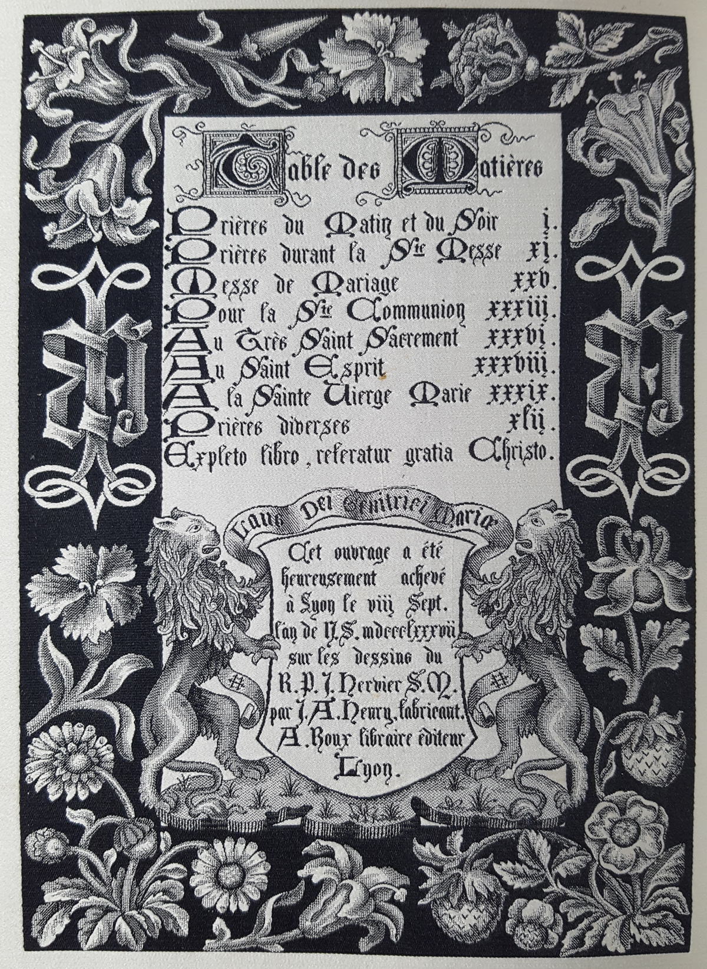
Livre de Prières: Table of Contents
List of contents
Colophon
(information about its publishing)

Slide 9
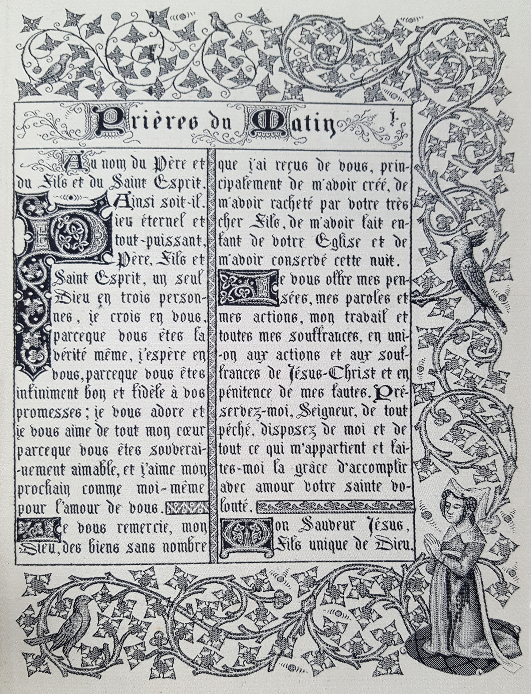
Livre de Prières: Prayer Page
Morning Prayers section
Illuminations throughout
2 columns
Unique borders

Slide 10
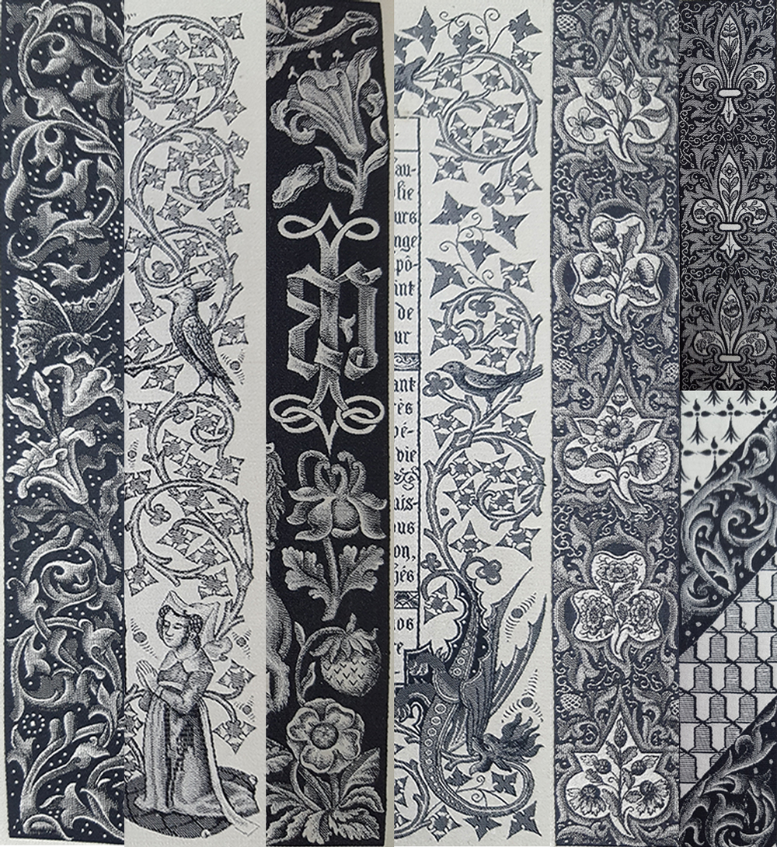
Livre de Prières: Unique Borders

Slide 11
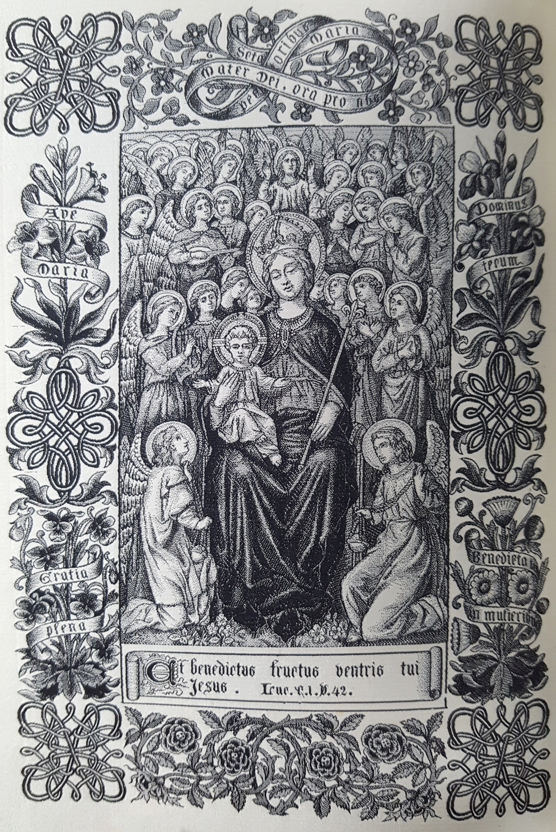
Livre de Prières: Illustrations
Virgin Mary of special importance
  Images of Mary
  Symbolism
    Fruit
    Flowers
    Fleur de lis
  Protector of Lyon, France
Several ____ full-page illustrations
throughout the book

Slide 12
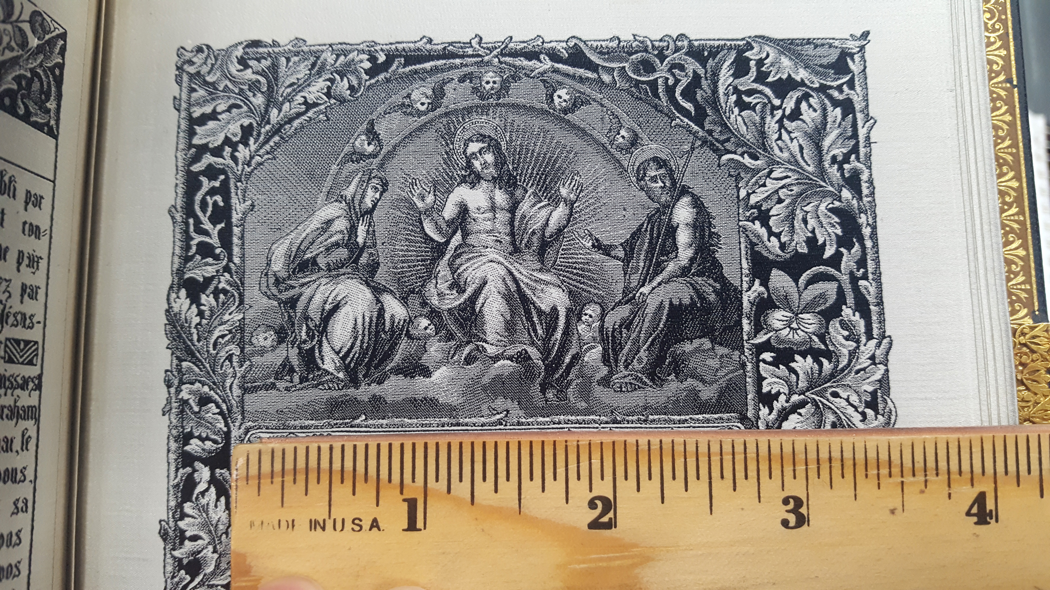
Livre de Prières: Close-Up Details

Slide 13
Livre de Prières: Material Culture Considerations
Prayer Book = object intended for daily use
Livre de Prières = object of value
How do we perceive its value?
  Special materials
  Intricate design
  Production technique
  Rarity
  Age
?
?
?

